Slide 1
Briefing: Reduction of Single-Use Plastic Packaging
February 13, 2024

Slide 2
Agenda
Background of Single-Use Plastics Rulemaking at GSA
  ANPR
  GAP FAC
Single-Use Plastics Proposed Rule
Comment Period
Status of other Sustainability Rules
Green Committee Priorities
Upcoming Events

Slide 3
Background
  In 2022, GSA published an advanced notice of proposed rulemaking that requested information on single-use plastics and packaging
  The Coalition responded to the ANPR, expressing support for waste reduction while raising concerns about potential effects on industry and customer agency missions. We recommended that:
  GSA avoid establishing GSA-unique requirements,
  Align any requirements with the EPA’s Environmentally Preferable Purchasing Program,
  Harmonize with existing packaging requirements, such as those in the Department of Defense,
  Avoid restricting particular materials, especially those used across the government,
  Consider effects on small businesses, and
  Ensure that the rule does not raise costs for contractors.
Notes:
Estimates vary on how much plastic use is in packaging, but packaging and containers are the largest single category of plastic use and account for around 42% of all plastics ever made
Subjects covered in the ANPR included supply chain effects, what degree of control the company has over its product’s packaging, cost and performance differences, if there are any single-use plastic products that should not be contracted for through the Federal supply schedules, regulatory/cost barriers to more environmentally friendly packaging
The Coalition’s response to the ANPR
ANPR did not include a particular proposed rule, was sent out in response to a petition from an environmental group asking to address single-use plastic packaging
Multiple states have passed legislation to address single use plastic packaging, such as California, which requires that all single-use packaging be recyclable/compostable by 2032

Slide 4
Background cont.
  In May of 2023, the GSA Acquisition Policy Federal Advisory Committee (GAP FAC) recommended that GSA pursue rulemaking to reduce single-use plastics and packaging through government procurement
  The GAP FAC also recommended that, in the short term, GSA “develop procurement pilots and facility-specific pilots to demonstrate the viability of strategies to mitigate single-use plastic and packaging waste”
  Some specific recommendations included:
    Developing a strategy to phase out single-use plastic products across GSA
    Improving bulk ordering processes to consolidate packaging
    Replace single-use plastic items like water bottles and disposable cutlery when feasible
Notes:
What the GAP FAC is
Group founded in 2022 as an advisory committee to provide recommendations on sustainable acquisition to the administrator, and includes industry/gov/academic members
Subcommittees on acquisition workforce, industry partnerships, and policy and practice
Issued first recommendations in May
GAP FAC also recommended that GSA develop procurement pilots and other facility-specific measures to reduce single-use plastics and packaging waste
The present rule does not address these plastics, but they are something to bear in mind, and we could see them in the future
Ideas include scheduling and bulk ordering processes, restricting single-use plastic items like soap dispensers, water bottles and utensils
GSA has not indicated that it has acted on these reccs

Slide 5
The Proposed Rule
GSA released the rule on December 26, 2023
An amendment to the General Services Administration Acquisition Regulation (GSAR)
  Further limited to Federal Supply Schedules (including the VA-managed Schedules)
Addresses only packaging, not other single-use plastic (SUP) products
Goal of the rule is to incentivize, not mandate, SUP-free packaging
Notes:
Definitions of brand and shipping packaging from the rule:
(1) Brand packaging, sales packaging or primary packaging is packaging intended to provide the user or consumer with the individual unit of the product, such as plastic casing.
(2) Shipping packaging, serves as protection for the goods to ensure safe transport to the end customer, including:
(i) Ancillary packaging or transport packaging is packaging intended to secure the product, such as packing peanuts, wrapping materials, or molded materials.
(ii) Grouped packaging or secondary packaging is packaging intended to bundle, sell in bulk, brand, or market/display products.

Slide 6
The Rule: Major Changes
Main Change: GSA will provide two icons within GSA Advantage! to identify (a) SUP-free brand packaging and (b) SUP-free shipping packaging
Encourages contractors to eliminate unnecessary packaging, limit the use of plastic packaging that has a high likelihood of not being reused, and “adopt SUP-free packaging to the maximum extent practicable”
Provides that Schedule users may focus GSA Advantage! searches on the SUP-free packaging icons to meet climate objectives
Notes:
Definitions of brand and shipping packaging from the rule:
(1) Brand packaging, sales packaging or primary packaging is packaging intended to provide the user or consumer with the individual unit of the product, such as plastic casing.
(2) Shipping packaging, serves as protection for the goods to ensure safe transport to the end customer, including:
(i) Ancillary packaging or transport packaging is packaging intended to secure the product, such as packing peanuts, wrapping materials, or molded materials.
(ii) Grouped packaging or secondary packaging is packaging intended to bundle, sell in bulk, brand, or market/display products.
“Packaging Availability” Clause also says to “Package all products for shipment according to the Government's instructions or, if there are no instructions, in a manner sufficient to ensure that the products are delivered in undamaged condition with as little plastic waste material as possible.”

Slide 7
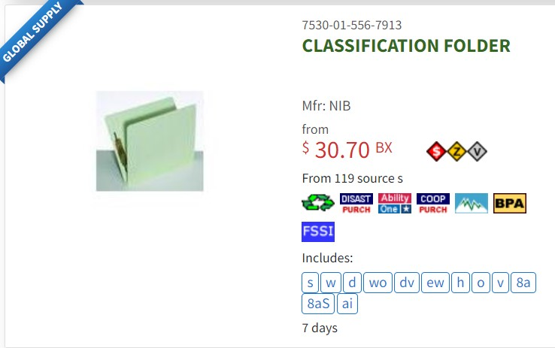
Icon Example
Notes:
GSA will add the icons in this area on advantage, and like others, it should be available as a filter. It’s not known yet what the icons will look like.

Slide 8
The Rule: Technical Details
At the contract level, contractors will identify if some or all of the supplies provided under the contract will be provided in SUP-free brand packaging or shipping packaging, and whether this is standard or must be requested by the ordering agency
Contractors will indicate in their submitted price list if a specific product has SUP-free packaging (in accordance with the MAS solicitation instructions), and whether this is available at a discount or a premium
Rule defines plastic, packaging, single-use plastic packaging and SUP-free packaging
Comments on the rule are due on February 26.
Notes:
Describe the Coalition comment process and encourage those interested to comment. Note our internal deadline and collect comments if they are provided verbally or in chat.
Deadline for member feedback:

Slide 9
Major Federal Sustainability Updates
Proposed/Planned Rules
  “Disclosure of Greenhouse Gas Emissions and Climate-Related Financial Risk:” review of public comments still in progress
  “Minimizing the Risk of Climate Change in Federal Acquisitions:” under review by OIRA, no proposed version yet available
  “Sustainable Procurement:” final rule under review by OIRA
Legislation
  Section 318 of the FY24 National Defense Authorization Act, “Prohibition on Required Disclosure by Department of Defense Contractors of Information Relating to Greenhouse Gas Emissions”
Notes:
Disclosure of Greenhouse Gas Emissions rule:
Part of climate related financial risk rule from 2021
Rule affects significant contractors (>7.5 million dollars in annual Federal obligations) and major contractors (>50 million dollars in annual Federal obligations)
Significant contractors must produce a GHG inventory, based on the GHG Protocol Corporate Accounting and Reporting Standard, of annual Scope 1 and Scope 2 emissions and disclose totals in the System for Award Management
Major contractors must do this and:
Conduct an inventory of their “relevant Scope 3 emissions,”
Complete an annual TCFD-aligned annual climate disclosure and post it on a public website,
Develop a science-based target, validate it with the Science Based Targets Initiative, and post it on a public website
Minimizing the Risk of Climate Change
Implements section 5(b)(ii) of Executive Order 14030, Climate-Related Financial Risk, which directs the FAR Council to consider amending the FAR to ensure that major agency procurements minimize the risk of climate change.
Sustainable procurement
Refocuses FAR part 23 to be solely about sustainability and consolidate requirements
Provides, per EO 14057, that agencies shall procure sustainable products to the “maximum extent practicable”
Eliminates requirement that Federal agencies only procure EPEAT-registered products, in favor of a standard that identifies sustainable products as those designated by a set of EPA programs (e.g. EPA ecolabels program)
CGP comments on applicability to service contracts, assessing compliance, notifying contractors of applicable ecolabels
The Enhancement and Standardization of Climate-Related Disclosures for Investors
Requires publicly traded companies to submit to several climate-related disclosures, including “climate-related risks and their actual or likely material impacts on the registrant’s business”
Also requires a Scope 1 and 2 GHG inventory
Companies not required to disclose Scope 3 emissions, unless they are material or if they have an emissions target or goal that includes them
Rule has been in the proposed stage since March 2022
Legislation
National Defense Authorization Act of FY24
Would prohibit GHG inventories for “nontraditional defense contractors” (see 10 USC 3014) as a condition of award, unless necessary to
and delay all DoD contractors from providing GHG inventories for one year
Waiver by SecDef to allow application of a disclosure requirement if the disclosure requirement is directly related to the performance of the contract.
Congress rejected a more expansive provision that would have generally banned such disclosures in DoD contracts

Slide 10
2024 Green Committee Priorities
Track legislation and policy related to sustainability, including proposed rules on greenhouse gas reporting
Comment on any proposed or interim sustainability-related rules released
Inform members of key sustainability related developments via the Green Committee mailing list
Create opportunities throughout the year for members to hear from and meet with key procurement officials working on sustainable acquisition at GSA, EPA, and DoD

Slide 11
Upcoming Events
Date​ | Event​ | Location​
February 16​ 10:00 AM ​ | Cloud Working Group Meeting on GSA's ASCEND BPA​ | Deloitte​ Arlington, VA (and Virtual)​
February 21 ​ 12:00 PM​ | Healthcare Focus: Briefing on the NDAA for Fiscal Year 2024​ | Webinar​
February 22 ​ 12:00 PM​ | The Latest Alliant 3 Draft RFP: A Review​ | Webinar​
February 27​ 8:30 AM​ | MAS Basic Training: The Nuts & Bolts​ | Miller & Chevalier Chartered Washington, DC (and Virtual)​
February 28 ​ 9:30 AM​ | GSA & VA Schedule Contracting Training for In-House Counsel​ | Miller & Chevalier Chartered Washington, DC (and Virtual)​
February 29 10:00 AM | Imaging Equipment Committee Meeting | Virtual
May 8-9​ | Spring Training Conference ​ | Fairview Park Marriott​ Falls Church, VA​

