Slide 1
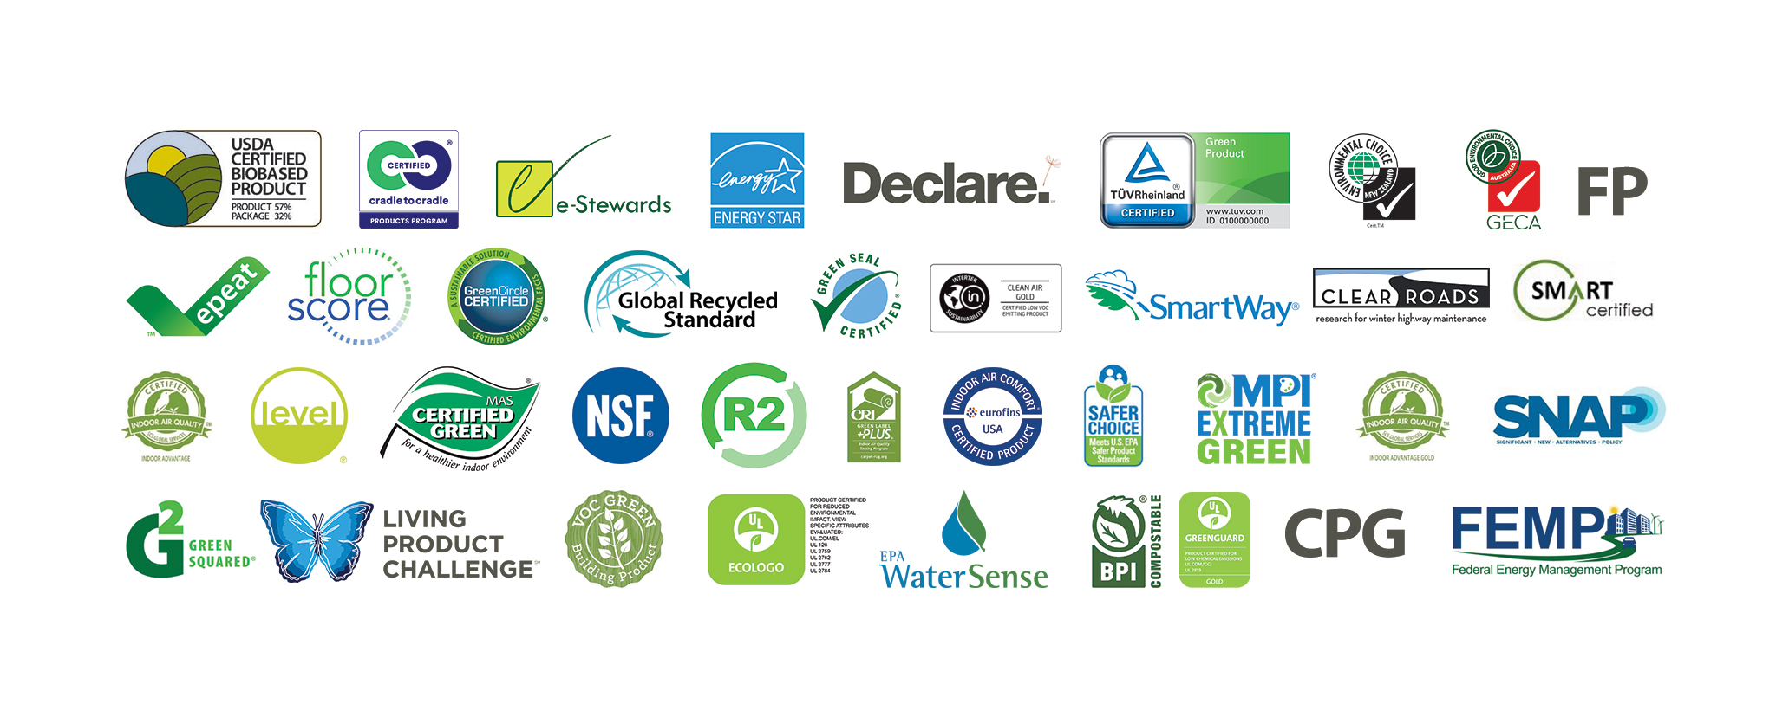
Environmental Protection Agency’s Environmentally Preferable Purchasing (EPP) Program
Coalition for Government Procurement Webinar
July 9, 2024
Jonathan Rifkin
Jenna Larkin

Slide 2
Agenda
Overview of updates to sustainable product and service requirements under the Federal Acquisition Regulation (FAR).
How the U.S. federal government utilizes ecolabels within procurement.
Deep dive into EPA’s Recommendations of Specifications, Standards, and Ecolabel for Federal Purchasing.
Q&A

Slide 3
FAR Case 2022-006: Overview of changes and impacts for the purchase of sustainable products and services

Slide 4
FAR Case 2022-006
Changes to FAR Effective May 22, 2024
In accordance with FAR Subpart 23.103(a) -- Agencies shall procure “sustainable products and services” to the maximum extent practicable.
Applicable to commercial and non-commercial products, micro-purchases, and both requirement and services contracts.
Note that “practicable” implies product meets minimum need, can be properly competed, and found at a reasonable price.

Slide 5
Background
Executive Order 14057
Memorandum M-22-06
Guidance on Purchasing Sustainable Products and Services
FAR Case 2022-006
Proposed Aug. 2023
Catalyzing Clean Energy Industries and Jobs Through Federal Sustainability
Issued April, 2024
Effective May 22, 2024

Slide 6
FAR Case 2022-006: Implications
Clarified & Streamlined FAR Part 23
Broadly Applicable Sustainability Requirements
CO and Contractor Roles Prioritize Sustainability
New definition of Products and Services helps stakeholders better understand how to identify Sustainable Products and Services.
Non-environmental matters transferred to FAR Part 26, and sustainability requirements grouped under like subparts.
A new sustainable Omnibus Clause 52.223-23, Sustainable Products and Services, groups sustainable requirements and is prescribed in all applicable contracts
Establishes purchase of Sustainable products and Services as government’s default position, to maximum extent practicable.
Applicable to all commercial procurements including micro-purchases, unless indicated otherwise.
Sustainable Product and Services requirements applicable to all service contracts where products are delivered, or used in performance of the contract
Emphasis on leveraging CO role to ensure sustainable products and services are identified in all requirements documents.
Omnibus clause 52.223-23 requires contractor delivers or uses sustainable products and services identified in award and performance of contract.
Prime contractors flow down the sustainable product and service clause to their subcontractors.

Slide 7
Additional Points to Note:
Provides guidance on Prioritizing Sustainable Products and Services: Under 52.223-23 contracting officers are instructed to prioritize the purchase of sustainable products and services meeting statutory programs, then EPA Preferred Programs. More detail is provided under 23.104(c)
Reasonable Price guidance expanded to all purchases: Expands an approach to cost reasonableness already embraced for energy consuming products. Aligns with EO14057 Implementing Instructions provided by CEQ.
Several previous stand-alone clauses consolidated under 52.223-23: Clauses being consolidated include those referencing use of EPEAT products, energy efficient products, and affirmative procurement of EPA-designated items*.
*Note that federal purchasers are still required to procure EPEAT registered electronic products as a result of EPEAT’s inclusion in the EPA Recommendations of Specifications, Standards, and Ecolabels.

Slide 8
3 Key Takeaways
New Definition at 2.101 defines Sustainable Products and Services
Statutory purchasing preference programs | EPA purchasing preference programs
FAR 23.107-1 Products containing recovered material designated by EPA under the Comprehensive Procurement Guidelines (CPG) program | FAR 23.108-1 WaterSense® labeled (water efficient) products and services
FAR 23.107-2 Biobased products meeting content requirements under the USDA BioPreferred® program | FAR 23-108-2 Safer Choice certified products (products that contain safer chemical ingredients)
FAR 23.107-3 ENERGY STAR® certified or Federal Energy Management Program (FEMP)-designated energy efficient products | FAR 23.108-3 Products and services that meet EPA Recommendations of Specifications, Standards, and Ecolabels
FAR 23.107-4 Acceptable chemicals, products, and manufacturing processes listed under EPA’s Significant New Alternatives Policy (SNAP) program
Newly Added FAR Language

Slide 9
3-Key Takeaways
Sustainable purchasing requirements are now USG default position
In accordance with 23.103(a) agencies shall procure “sustainable products and services” to the maximum extent practicable (in place of previous 95% target requirement by agency).
In accordance with 23.109(a) COs must ensure the inclusion of FAR Clause 52.223-23, Sustainable Products and Services, requires that the contractor delivers or uses sustainable products and services identified in award and performance of the contract.

Slide 10
3 Key Takeaways
Contracting Officer must ID Sustainable Products and Services
CO to identify Sustainable Products and Services - FAR 23.104(b) and 52.223-23(b) were revised to require the contracting officer to ensure that the solicitation / contract identifies sustainable products and services that are applicable to the acquisition as identified by the requiring activity -- accounting for justifications, exceptions, exemptions.
Incorporate Sustainability Considerations into Market Research – FAR Part 10 was revised to include language that ensures use of sustainable products and services to the maximum extent practicable.
Incorporate Sustainability Considerations into Acquisition Plan - Aligns with FAR 11.002(d)(1), which requires agencies to incorporate use of sustainable products and services when describing agency requirements.

Slide 11
Exceptions, Exemptions, and Justifications
Contracting officer shall—
Include new omnibus clause at 52.223-23, Sustainable Products and Services, in all solicitations and contracts, unless the entirety of the contract action is covered by—
A written justification that it is not practicable from requiring activity (23.103)
An authorized exception (23.105)
An authorized exemption (23.106)
Identify in the solicitation any products and services that are not subject to the omnibus clause based on a written justification, exception, or exemption (23.104(b))

Slide 12
For more information:
For more information about the FAR Case please visit the Federal Register and to read the most up-to-date version of the FAR please visit acquisition.gov and regulations.gov.

Slide 13
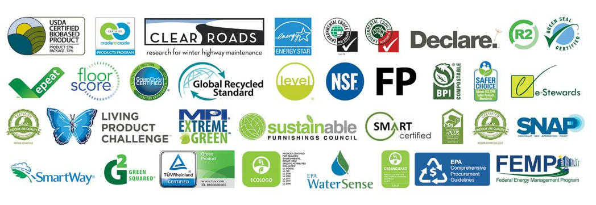
FAR 23.1: Highlights EPA Programs
Federal Acquisition Regulation Updates (effective May 22, 2024)
Part 23.108 directs contracting officers, after meeting statutory purchasing program requirements in 23.107, to purchase to the maximum extent practicable products and services that meet required EPA purchasing programs. EPA’s Recommendations of Specifications, Standards and Ecolabels is one of the required EPA purchasing programs (23.108–3).
* * * * *
The rule will require compliance with the EPA Recommendations in effect as of October 2023.

Slide 14
Other U.S. Federal Government Sustainable Acquisition Directives
Executive Order 14057 & Implementing Instructions
Federal Sustainability Plan
OMB Memo 22-06
Net-zero emissions procurement by 2050
Prioritize products that can be reused, refurbished, or recycled
Prioritize products/services addressing multiple environmental impacts
Prioritize products that do not contain PFAS.
Take actions to reduce and phase out procurement of single-use plastic products
Ensure compliance with statutory mandates and procurement of products/ services identified or recommended by EPA.

Slide 15
Statutory Purchasing Preference Programs
EPA’s Significant New Alternatives Policy Program (Ozone Depleting Substances)
EPA’s Comprehensive Procurement Guidelines
(Recycled Content)
USDA’s BioPreferred Program
(Biobased Content)
DOE’s Federal Energy Management Program (Energy & Water Efficiency)
EPA’s ENERGY STAR (Energy Efficiency)
EPA Purchasing Preference Programs
EPA’s Recommendations of Specifications, Standards and Ecolabels
(focus on private sector standards/ecolabels)
EPA’s WaterSense (Water Efficiency)
EPA’s Safer Choice Program
(Safer Chemical Ingredients)

Slide 16
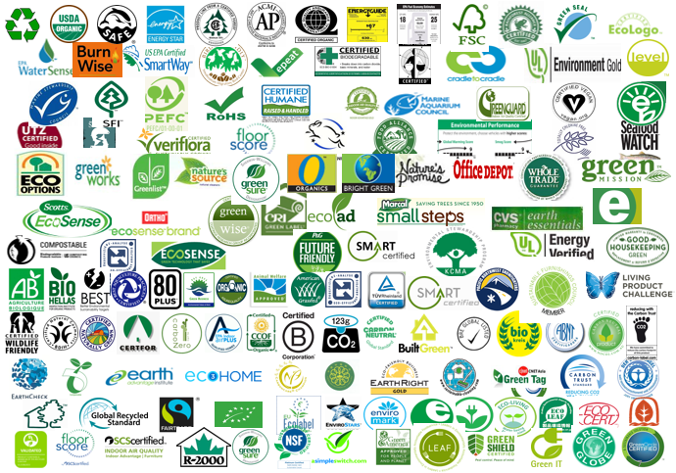
Ecolabels Found in the Global Marketplace Today (460+)
16

Slide 17
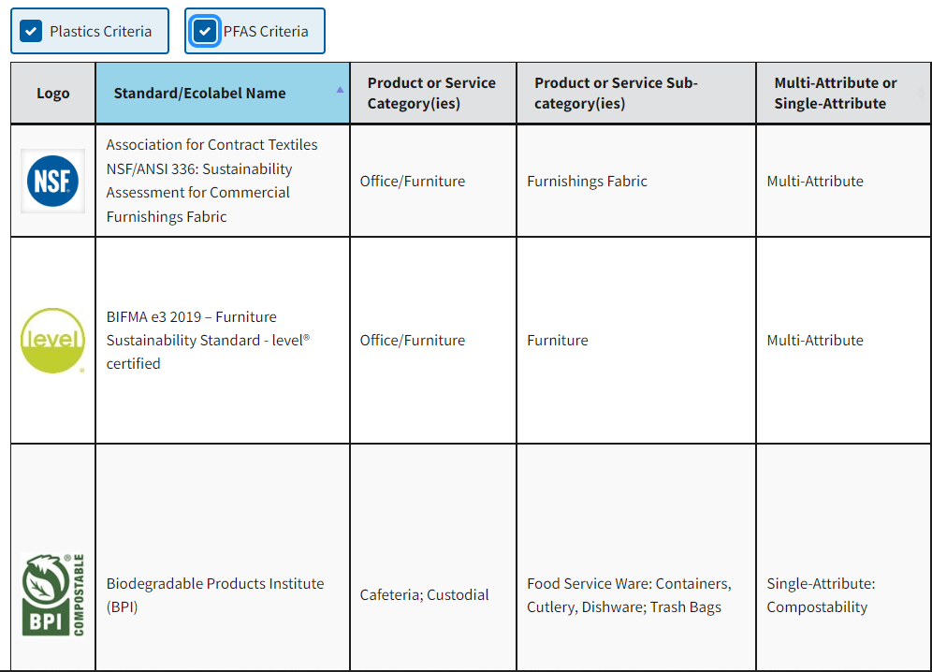
Recommendations of Specifications, Standards, and Ecolabels for Federal Purchasing
Global Marketplace
460+ Standards/Ecolabels
The Recommendations
34 product/service categories, 40+ private sector standards/ecolabels, 3 specifications
Based on review and use by another federal agency
Required by the FAR
Based on an assessment against EPA’s Framework for Environmental Performance Standards and Ecolabels

Slide 18
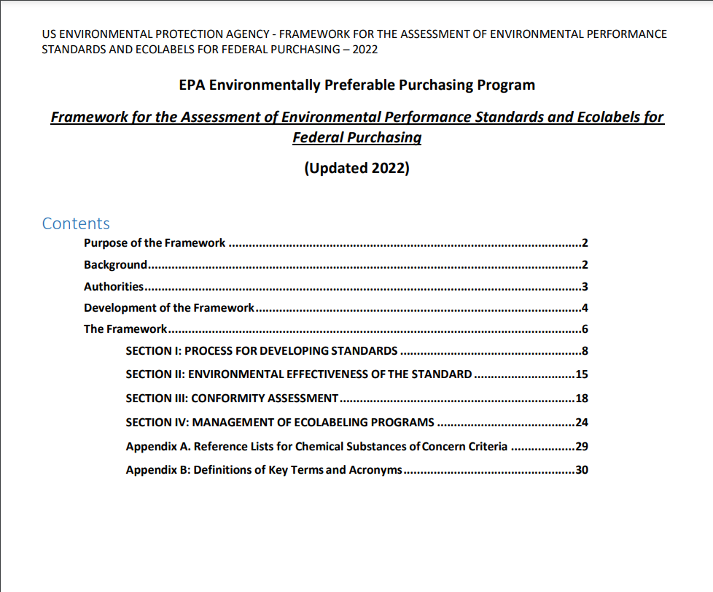
Framework for Assessment of Environmental Performance Standards and Ecolabels
Section I: Standards development process
Section II: Effectiveness in addressing human and environmental health
Section III: Conformity assessment procedures
Section IV: Ecolabel program management

Slide 19
Product Categories Covered by the Recommendations
*Standards/ecolabels in these categories were assessed against EPA’s Framework
Cafeteria
Electronics & Associated Services
Custodial
Food Service Ware: Containers, Cutlery, Dishware
Commercial Dishwasher Detergent
Computers
Cloud Services
Electronics Recycling Services
Energy Savings Performance Contracts
Imaging Equipment
Mobile Phones
Network Equipment
Print Management Services
Photovoltaic Modules and Inverters
Power Purchase Agreements
Seat Management Services
Servers
Televisions
Wireless Services
Cleaners: Carpet, Glass, Multipurpose
Floor Care
Hand Soap
Bathroom Tissue
Paper Towels
Trash Bags
Construction
Adhesives
Carpet*
Ceiling Tiles-Acoustical
Fiberboard, Gypsum Panels, and Wallboard
Flooring*
Insulation
Interior Latex Paint*
Other Miscellaneous Building Finishes*
Grounds/Landscaping
Deicer
Office/Furniture
Machine Shop Operations
Copy Paper
Furniture*
Parts Wash Solution

Slide 20
Expansion of EPA’s Recommended Standards and Ecolabels
EPA is in the process of assessing additional private sector standards/ecolabels for possible inclusion into the Recommendations.
Expansion Categories:
Food Service Ware
Uniforms/clothing
Professional services
Laboratories
Healthcare

Slide 21
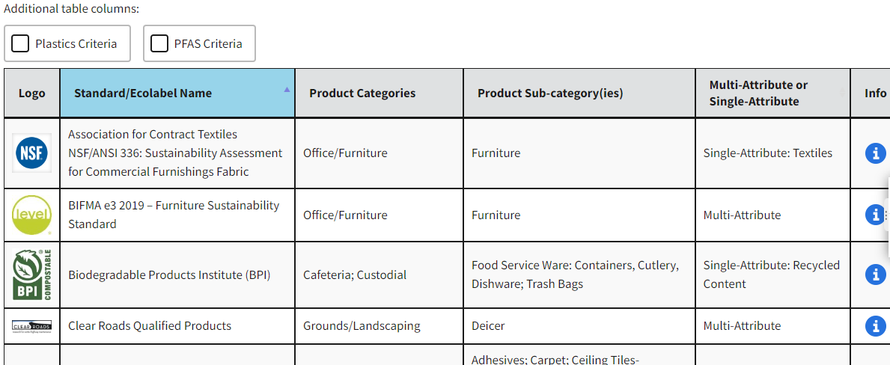
New Recommendations Tool

Slide 22
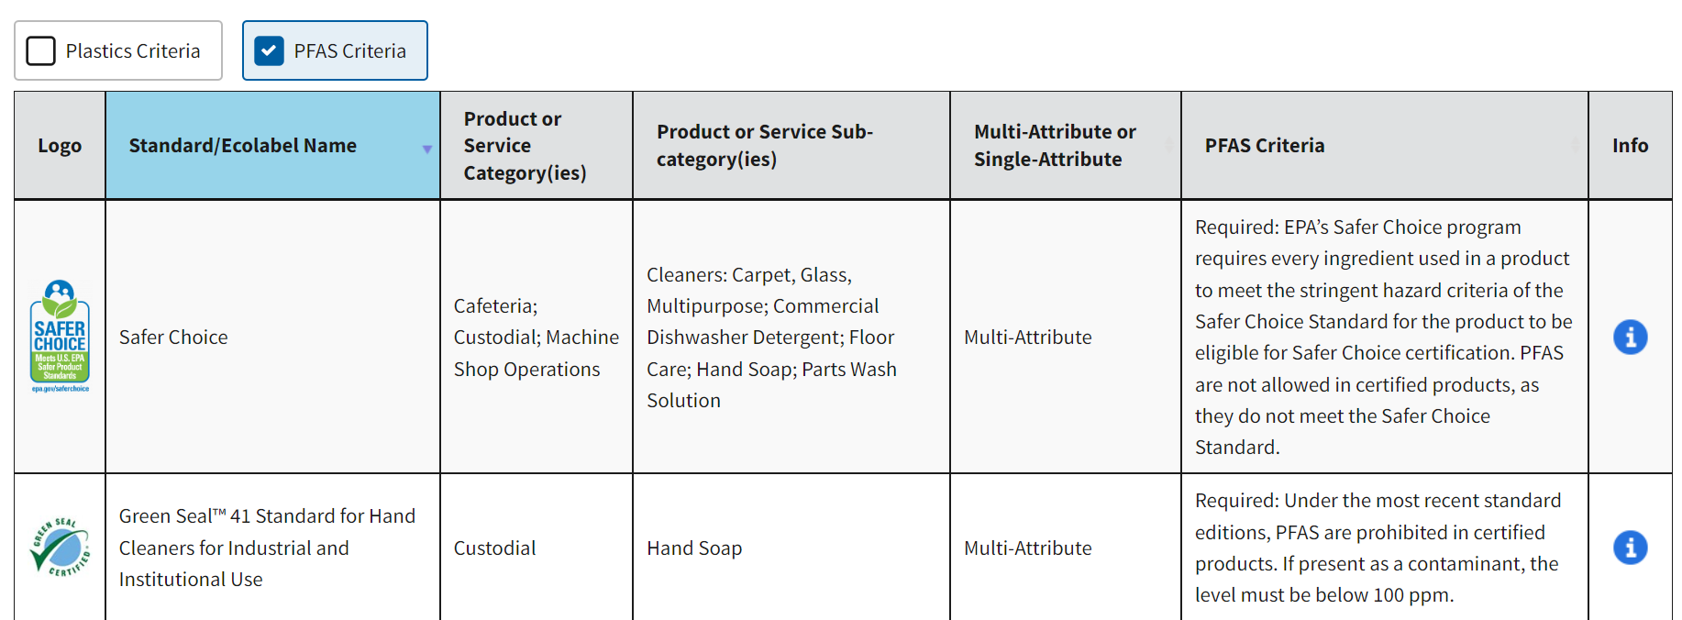
PFAS Criteria Filter
epa.gov/greenerproducts/recommendations-specifications-standards-and-ecolabels-federal-purchasing

Slide 23
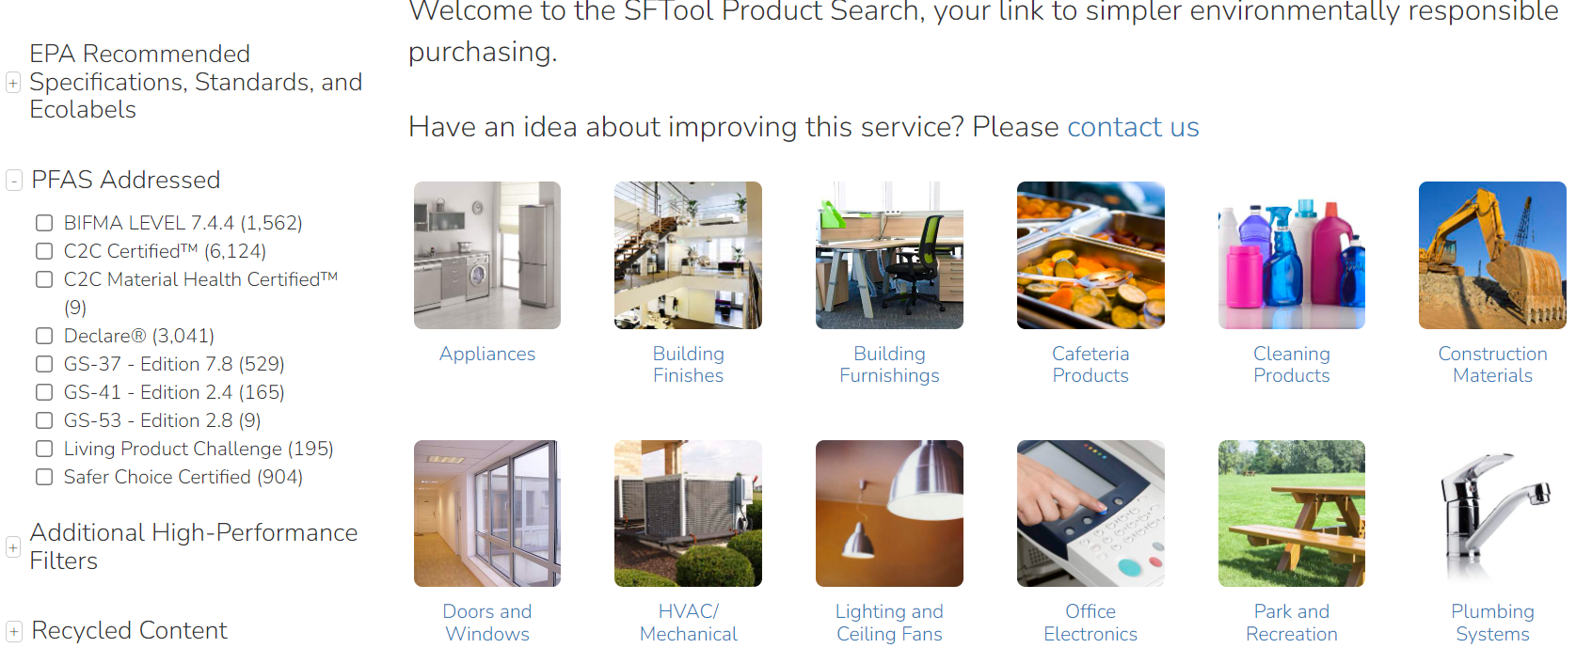
GSA’s Sustainable Facilities Tool (SFTool) Product Search: “PFAS Addressed Filter”
sftool.ecomedesdemo.com

Slide 24
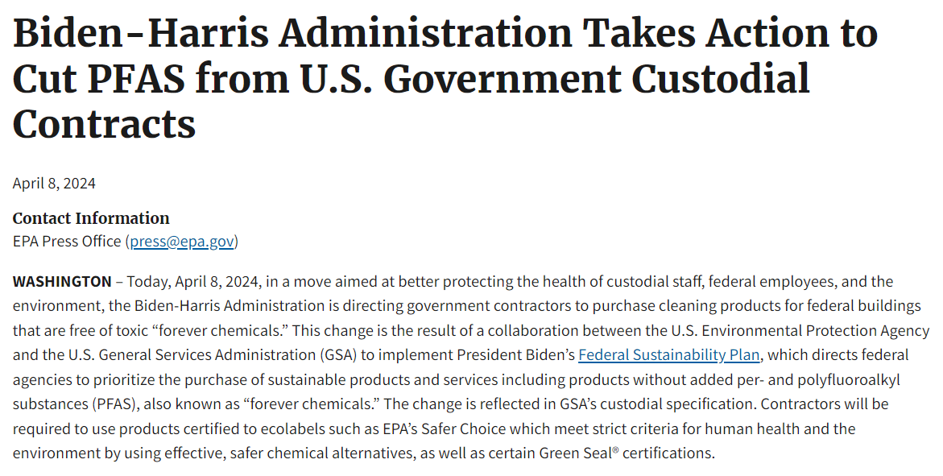
Cutting PFAS from Government Custodial Contracts

Slide 25
Let’s Connect!
Email:
epp@epa.gov
epa.gov/greenerproducts

