Slide 1
Imaging Equipment Committee Meeting
June 8, 2023

Slide 2
Agenda
DLA Document Services Briefing
Special Guest: Terra Nguyen, Director, DLA Office of Document Services
Welcome Committee Co-chair
Scott Massey, National Director, Gov't Sales and Marketing, Konica Minolta Business Solutions U.S.A.
Cybersecurity Standards Update
FAS Catalogue Platform Pilot
“Highly Competitive” Pricing Language
GHG Reporting Requirements
Upcoming Events
Closing

Slide 3
DLA Document Services Briefing Terra Nguyen Director, DLA Office of Document Services

Slide 4
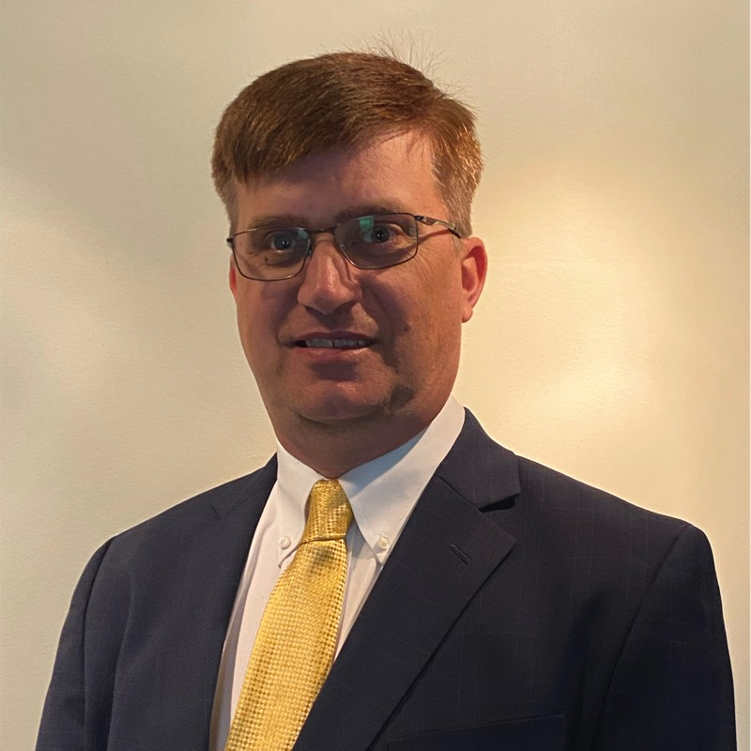
Co-chairs
Scott Massey
National Director, Gov't Sales and Marketing
Konica Minolta Business Solutions U.S.A., Inc.
smassey@kmbs.konicaminolta.us
Scott Hammond
Senior Contracts Manager, Federal Compliance
Federal Contracts
RICOH USA, Inc.
Scott.E.Hammond@ricoh-usa.com

Slide 5
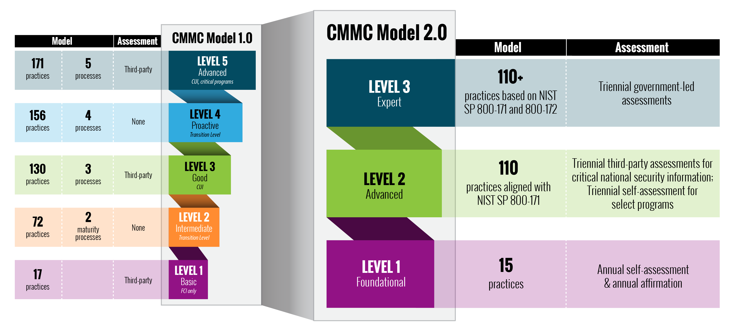
Cybersecurity Maturity Model Certification 2.0
The Cybersecurity Maturity Model Certification (CMMC) is an upcoming framework for DoD Federal contractors and subcontractors to ensure controlled unclassified information is properly protected.
As DoD continues to work on revisions the current release is unknown, but the proposed rule was expected to come in June.
However, as of May 31, the SBA has not received a copy of the proposed rule which pushes the release back.

Slide 6
NIST SP 800-171, Revision 3
Currently the National Institute of Standards and Technology is accepting comments to NIST SP 800-171, Protecting Controlled Unclassified Information in Nonfederal Systems and Organizations the underlying regulation to CMMC.
Significant changes NIST SP 800-171, Revision 3 include:
Updates to the security requirements and families to reflect updates in NIST SP 800-53, Revision 5 and the NIST SP 800-53B moderate control baseline
Updated tailoring criteria
Increased specificity for security requirements to remove ambiguity, improve the effectiveness of implementation, and clarify the scope of assessments
Introduction of organization-defined parameters (ODP) in selected security requirements to increase flexibility and help organizations better manage risk
A prototype CUI overlay
Comments are due on July 14, 2023. Revisions are expected to be completed by Fourth Quarter of the calendar year.

Slide 7
FAS Catalog Platform
The FAS Catalog Platform continues its pilot for companies under the Office Supplies OS4 SIN.
The new FAS Catalog Platform (FCP) is designed to make it simpler for Multiple Award Schedule contractors to access and manage product and service details. This platform is the replacement for the Schedule Input Program.
The FCP reduces data entry needs and improves data integrity by integrating with GSA contract writing systems. This improves GSA Advantage’s catalog information for customers making purchasing decisions. The FCP includes features such as:
Automated business rules, data validations, and system notifications to provide contractors near-real-time feedback on submissions.
Automated Compliance & Pricing (C&P) Report helps contractors establish and maintain compliant and competitive catalogs.
Shared user interface with GSA contracting officer and Vendor Support Center (VSC) help desk support provides insight to action statuses and enables the VSC to assist users more effectively.
Central view for Authorized Negotiators with all catalog actions and a downloadable version of last-approved catalog makes it easier for contractors to manage catalog details.
Automated publishing to GSA Advantage! through integration with eMod reduces data entry for contractors and improves catalog quality for customers
The agency anticipates onboarding additional MAS product catalog contractors starting October 2023 and will continue in phases until all vendors are using the FCP. Contractors interested in moving to FCP should fill out the FCP transition form to provide key catalog information.

Slide 8
“Highly Competitive” Pricing Language
MAS Solicitation Language (Refresh 15 & 16)
Section III – Price Proposal
i. Applicable to both product and service offers. GSA's pricing goal** is to obtain equal to or better than the offeror’s Most Favored Customer (MFC) pricing under the same or similar terms and conditions. GSA seeks to obtain the offeror's best price based on its evaluation of discounts, terms, conditions, and concessions offered to commercial customers. However, offers that propose Most Favored Customer pricing that is not highly competitive will not be determined fair and reasonable and will not be accepted. The U.S. Government Accountability Office has specifically recommended that "the price analysis GSA does to establish the Government's MAS negotiation objective should start with the best discount given to any of the vendor's customers."
**This requirement does not apply to offerors/contractors that will be participating in TDR.
Notes:
Refresh 15 (Jan 23)
Refresh 16 (May 23)

Slide 9
Coalition Response
Recommended that the MAS solicitation be updated to-
Remove the "highly competitive" language and
Ensure that awarded pricing under the Schedules program is fair and reasonable
Blogs and Letter to GSA
Letter to GSA Recommending that the "Highly Competitive" language be removed from the Schedules solicitation (May 31, 2023)
Blog: “Pathways” to the Federal Acquisition Service’s North Star Goals (May 19, 2023)
Blog: An Unnecessary, Counter-Productive Multiple Award Schedule Marketplace Hurdle (May 12, 2023)
Blog: Putting the Puzzle Together to “Deliver” for Customer Agencies (April 7, 2023)

Slide 10
GSA Removes “Highly Competitive” Requirement
Interact blog post published on June 1
GSA announced the end of a requirement that pricing be "highly competitive" for an offeror to receive a Multiple Award Schedule (MAS) contract
GSA is removing the “highly competitive” language via Refresh 16 to the MAS solicitation
The requirement is no longer in effect
Conforming changes to the solicitation that will remove the language from the solicitation itself are scheduled for Refresh 17 in July 2023

Slide 11
Upcoming GHG Reporting Requirements
Greenhouse Gas (GHG) Disclosure and Climate-related Financial Risk Proposed Rule (Nov 14, 2022)
Proposes to amend the FAR to require contractors to report GHG emissions and to set reduction targets
Impacts contractors with $7.5 million + in Federal sales
$7.5 - $50M in annual Fed sales => “Significant” contractor
More than $50M in annual Fed sales => “Major” contractor
Exceptions include Alaska Native Corporations, Indian or Tribally owned concerns, Higher Education, Nonprofit research, State and Local Government
Contractors required to comply via representations in SAM.gov

Slide 12
Representations in SAM.gov
Identify whether the contractor is a Significant contractor or Major contractor based on the prior FY Federal sales
If an Exception applies
Whether the Significant or Major contractor has completed a GHG inventory of its annual Scope 1 and Scope 2 emissions in the previous fiscal year
Report the total Scope 1 and 2 emissions
For Major contractors (although Significant contractors will also be asked), report whether the following is posted on a public website*:
Annual climate disclosure based on the CDP Climate Questionnaire
Science-based targets validated by the SBTi (Science-Based Targets Initiative)
The location of these postings
For Major contractors, report total Scope 3 emissions*
* Required of Major contractors 2 years after publication of final rule. All other representations beginning one year after final rule published.

Slide 13
Impacts on Small Business
Small businesses are covered
If receive > $7.5M then must report Scope 1 and 2 emissions
If receive > $50 million are exempt from Major contractor requirements (e.g., reduction goals and Scope 3 emissions reporting)

Slide 14
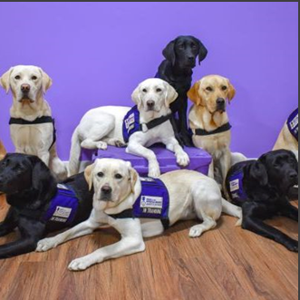
Upcoming Events
MAS Hot Topics with the Gormley Group, June 13
All Member Meeting with Erv Koehler, June 28
Primes and Subs Small Business Committee Event, Late July (TBA)
Joseph P Caggiano Memorial Golf Tournament, August 16

Slide 15
Committee Next Steps
Please send requests for Government speakers and/or Topics for future meetings to-
Joseph Snyderwine
Policy Analyst
The Coalition for Government Procurement
Mobile: 440.413.2252
JSnyderwine@thecgp.org

Slide 16
Thank you

